Slide 1

Cheat Detection in Chess: Analyzing PGN Files
Dissertation Presentation
BITS ID - 2022AC05327
Ankita Pal, WILP BITS Pilani - MTech in AI & ML February 2025
Supervisor: Milin Shah, VP and Technology Manager at Bank of America

Slide 2
Presentation overview
1. Introduction to Chess Cheating | 7. Results & Statistical Analysis
2. Problem Statement & Significance | 8. Challenges & Limitations
3. Research Objectives & Contributions | 9. Conclusions & Key Findings
4. Literature Review & Current Approaches | 10. Future Work & Enhancements
5. Methodology Framework | 11. Discussion
6. Implementation Details | 12. Q&A

Slide 3
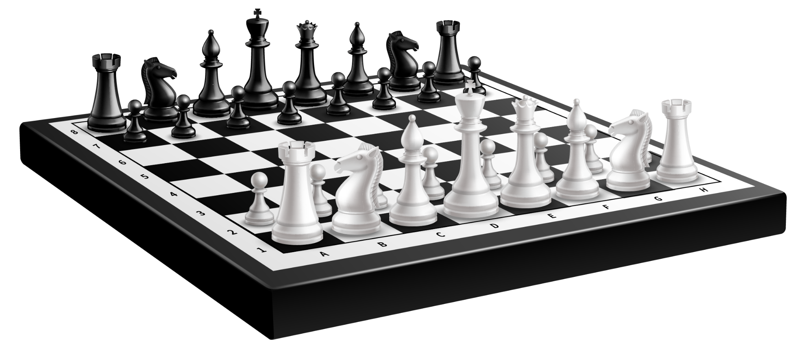
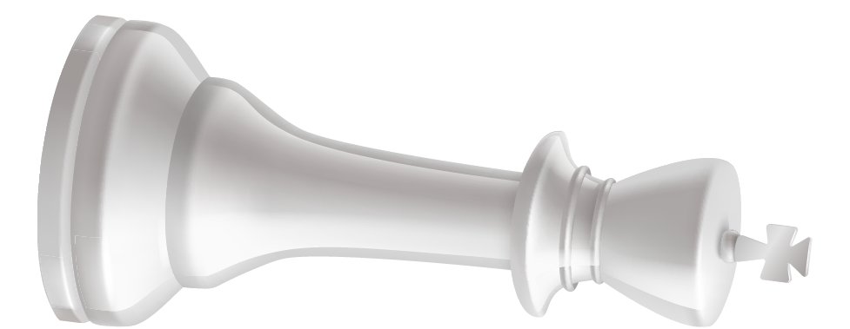
01
INTRO

Slide 4
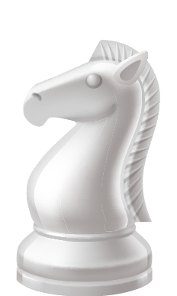
INTRODUCTION to chess cheating
Cheating in chess on online platforms is on a constant rise. There’s been an increased prevalence since 2020. Engine assistance: Stockfish, Leela Chess Zero & AlphaZero provide superhuman move accuracy

Slide 5

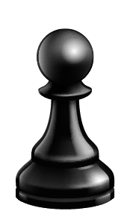
Detection challenges
No physical tells in online environments
Sophisticated methods (toggling between screens, consulting engines selectively)
Varying skill levels making baseline difficult to establish
Impact on Chess Community: Erosion of trust and competitive integrity
Need for automated detection: Statistical methods to complement human arbitration

Slide 6
02
Problem statement

Slide 7
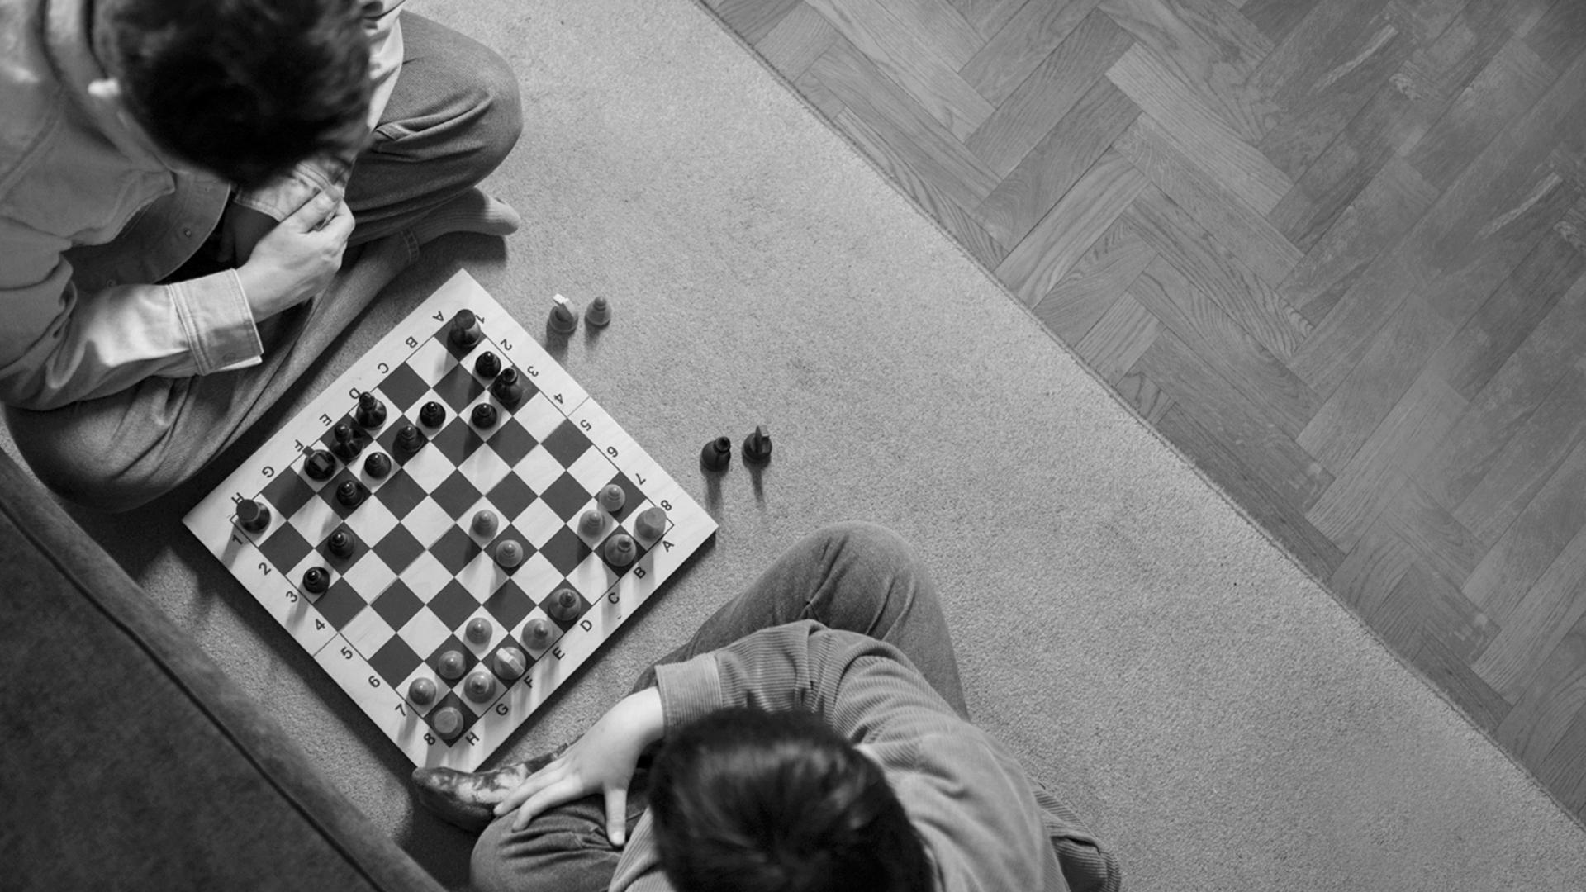
Primary problem: traditional anti-cheating methods rely heavily on elo ratings and simple move-matching

Slide 8
Limitations of current approaches:
Proprietary “black box” algos
High false positive rates
Difficulty in distinguishing coincidental engine alignment from cheating
Research question: Can PGN analysis identify statistical anomalies indicative of computer assistance?
Significance: Maintaining competitive integrity in online patforms, supportive tournament arbiters with objective evidence, providing transparent detection methods

Slide 9
03
Research objectives & contributions

Slide 10
Primary objectives
01
02
03
04
Develop automated framework for cheat detection using PGN data
Implement CPL metrics to evaluate move precision
Create visualization tools for pattern identification
Build machine learning models to classify suspicious play

Slide 11
Novel contributions:
Integration of multiple detection parameters (not just engine matching)
Focus on game-length analysis as a complementary indicator
Open-source approach with transparency in methodology
Use of modern ML techniques (achieving 95% accuracy with Neural Networks)

Slide 12
What is CPL (Centipawn Loss)?
Definition: Numerical measure of move quality relative to optimal engine move
100 centipawns = value of one pawn
Lower CPL = closer to perfect (engine) play
CPL Characteristics:
Grandmasters: ~15-20 average CPL
Club players: ~50-100 average CPL
Beginners: ~150+ average CPL
Detection Relevance:
Unnaturally consistent low CPL across games suggests engine assistance
Important to consider game complexity, time controls, and position criticality
Pattern of CPL more revealing than absolute values

Slide 13
04
Literature review

Slide 14
Literature review
Historical Development:
Early statistical approaches (Regan & Haworth, 2011)
Chess.com's proprietary system development (2014-present)
Lichess's IRWIN detector (2017)
Current Detection Methods:
Z-score analysis of move matching percentages
Time usage patterns and correlation with move difficulty
Move consistency across different game phases
Player performance deviation from historical results
Research Gaps:
Limited transparency in commercial implementations
Inadequate contextual move analysis
Challenges in real-time monitoring and intervention
Scarcity of labeled datasets for supervised learning

Slide 15
05
Methodology framework

Slide 16
PGN Analysis Methodology
Start
Load PGN file with game data
Parse PGN file
Extract game sequence and player data
Analyse Moves
Analyze for parameters by cross-reference with AI evaluation
Generate Report
Summarise analysis including detected anomalies
End

Slide 17
Process flow
01
Game data
Extract game data and player information
02
compute
Compute move-by-move engine metrics
03
CPL
Apply CPL and other metrics
04
Analysis
Generate comprehensive analysis report

Slide 18
06
implementation

Slide 19
Implementation
Dataset Composition:
PGN files from Chess.com and Lichess
Range of Elo ratings (800-2500)
Mix of known fair games and confirmed cheating cases
Various time controls (bullet, blitz, rapid, classical)
Technology Stack:
Python with chess.pgn library for parsing
Stockfish 16 for engine analysis (depth 20)
Pandas for data manipulation
Matplotlib and Seaborn for visualization
Scikit-learn and TensorFlow for ML models
Implementation Challenges:
Handling large PGN files efficiently
Optimizing engine analysis time
Accounting for different time controls in evaluation

Slide 20
Centipawn Loss Across Moves
Load GameData
Load PGN or game date to extract the moves
Calcuate Centipawn Loss
Evaluate each move's centipawn loss by comparison with best possible move
Visualise Results
Plot graph showing centipawn loss across all moves to identify trends

Slide 21
Centipawn loss calculation process
Implementation Details:
Extraction of move sequences in UCI format
Engine evaluation at consistent depth (depth 20)
Calculation formula: CPL = max(0, evaluation_before_move - evaluation_after_opponent_best_response)
Exclusion of book moves (first 10 moves) to reduce noise
Special handling for forced moves and time trouble positions

Slide 22
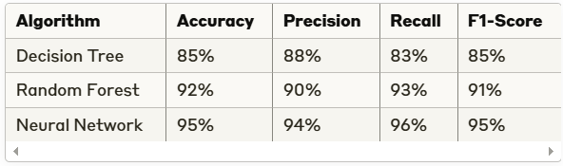
Machine learning model performance
Feature Engineering:
Average CPL across game phases
CPL variance and standard deviation
Move matching percentage with top engine choices
Time usage patterns and correlation with move complexity
Game length relative to player rating
Model Selection Rationale:
Neural Network provides best overall performance
Random Forest offers good interpretability with strong results
Decision Tree serves as baseline and provides explainable rules

Slide 23
07
Results & analysis

Slide 24
Results: identifying suspicious patterns
Primary indicators
Secondary indicators
Consistently low CPL across complex positions
Unnatural CPL stability
High alignment with top engine choices in critical positions
Incongruence between move strength and player rating
Unusual game length patterns
Inconsistent time usage (very quick complex moves)
Performance spikes in specific tournaments or time periods
Drastic improvement without corresponding rating increase

Slide 25
Classification thresholds
Medium confidence
High confidence
LOW confidence
Only secondary indicators present
One primary + multiple secondary indicators
Multiple primary indicators present

Slide 26
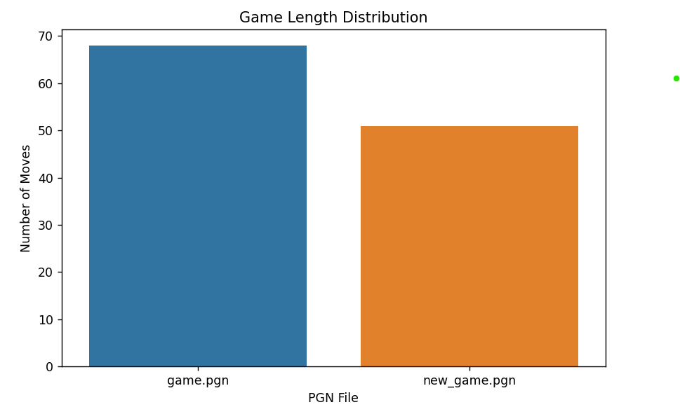
Game length distribution analysis
Analytical Insights:
Normal distribution centered around 40 moves for fair play
Bimodal distribution for suspicious accounts:
Very short games (quick wins with engine assistance)
Very long games (prolonged optimal defense)
Correlation between game length and outcome for suspected cheaters
Time control influence on distribution patterns

Slide 27
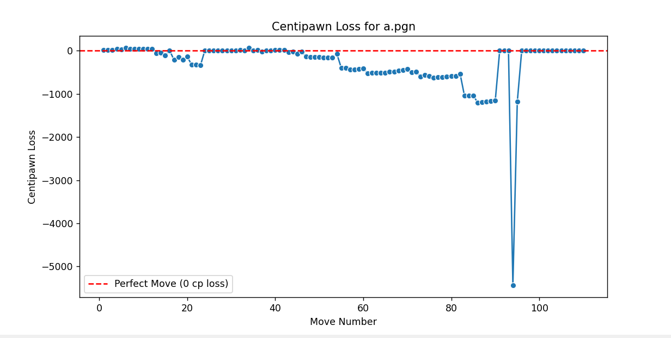
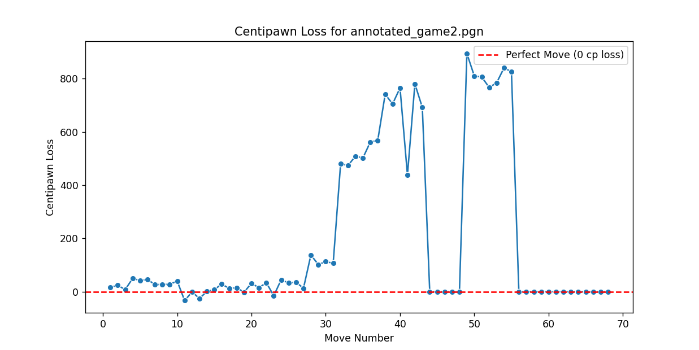
CPL Trend Analysis
Pattern Interpretation:
Figure 1: Typical human player showing variable CPL with occasional spikes
Figure 2: Suspected engine assistance showing unnaturally flat, low CPL
Key Observations:
Critical position identification (where decisions are complex)
Move timing correlation with CPL (suspiciously quick perfect moves)
Consistency across multiple games from same player
Phase-specific analysis (opening, middlegame, endgame)

Slide 28
08
Challenges & limitations

Slide 29
technical challenges (TC) & methodological limitations (ML)
01
02
03
04
05
06
TC: Computational intensity of engine analysis
TC: Handling different chess engine versions/depths
TC: Accommodating various time controls in analysis
ML: Reliance on annotated PGN files for training data
ML: False positives with very strong human players
ML: Intentional suboptimal play to avoid detection

Slide 30
Ethical considerations
False accusation
transparency
privacy
Balancing detection with false accusation risk
Transparency in methodology to ensure fairness
Privacy concerns with player data analysis

Slide 31
09
Conclusions & key findings

Slide 32


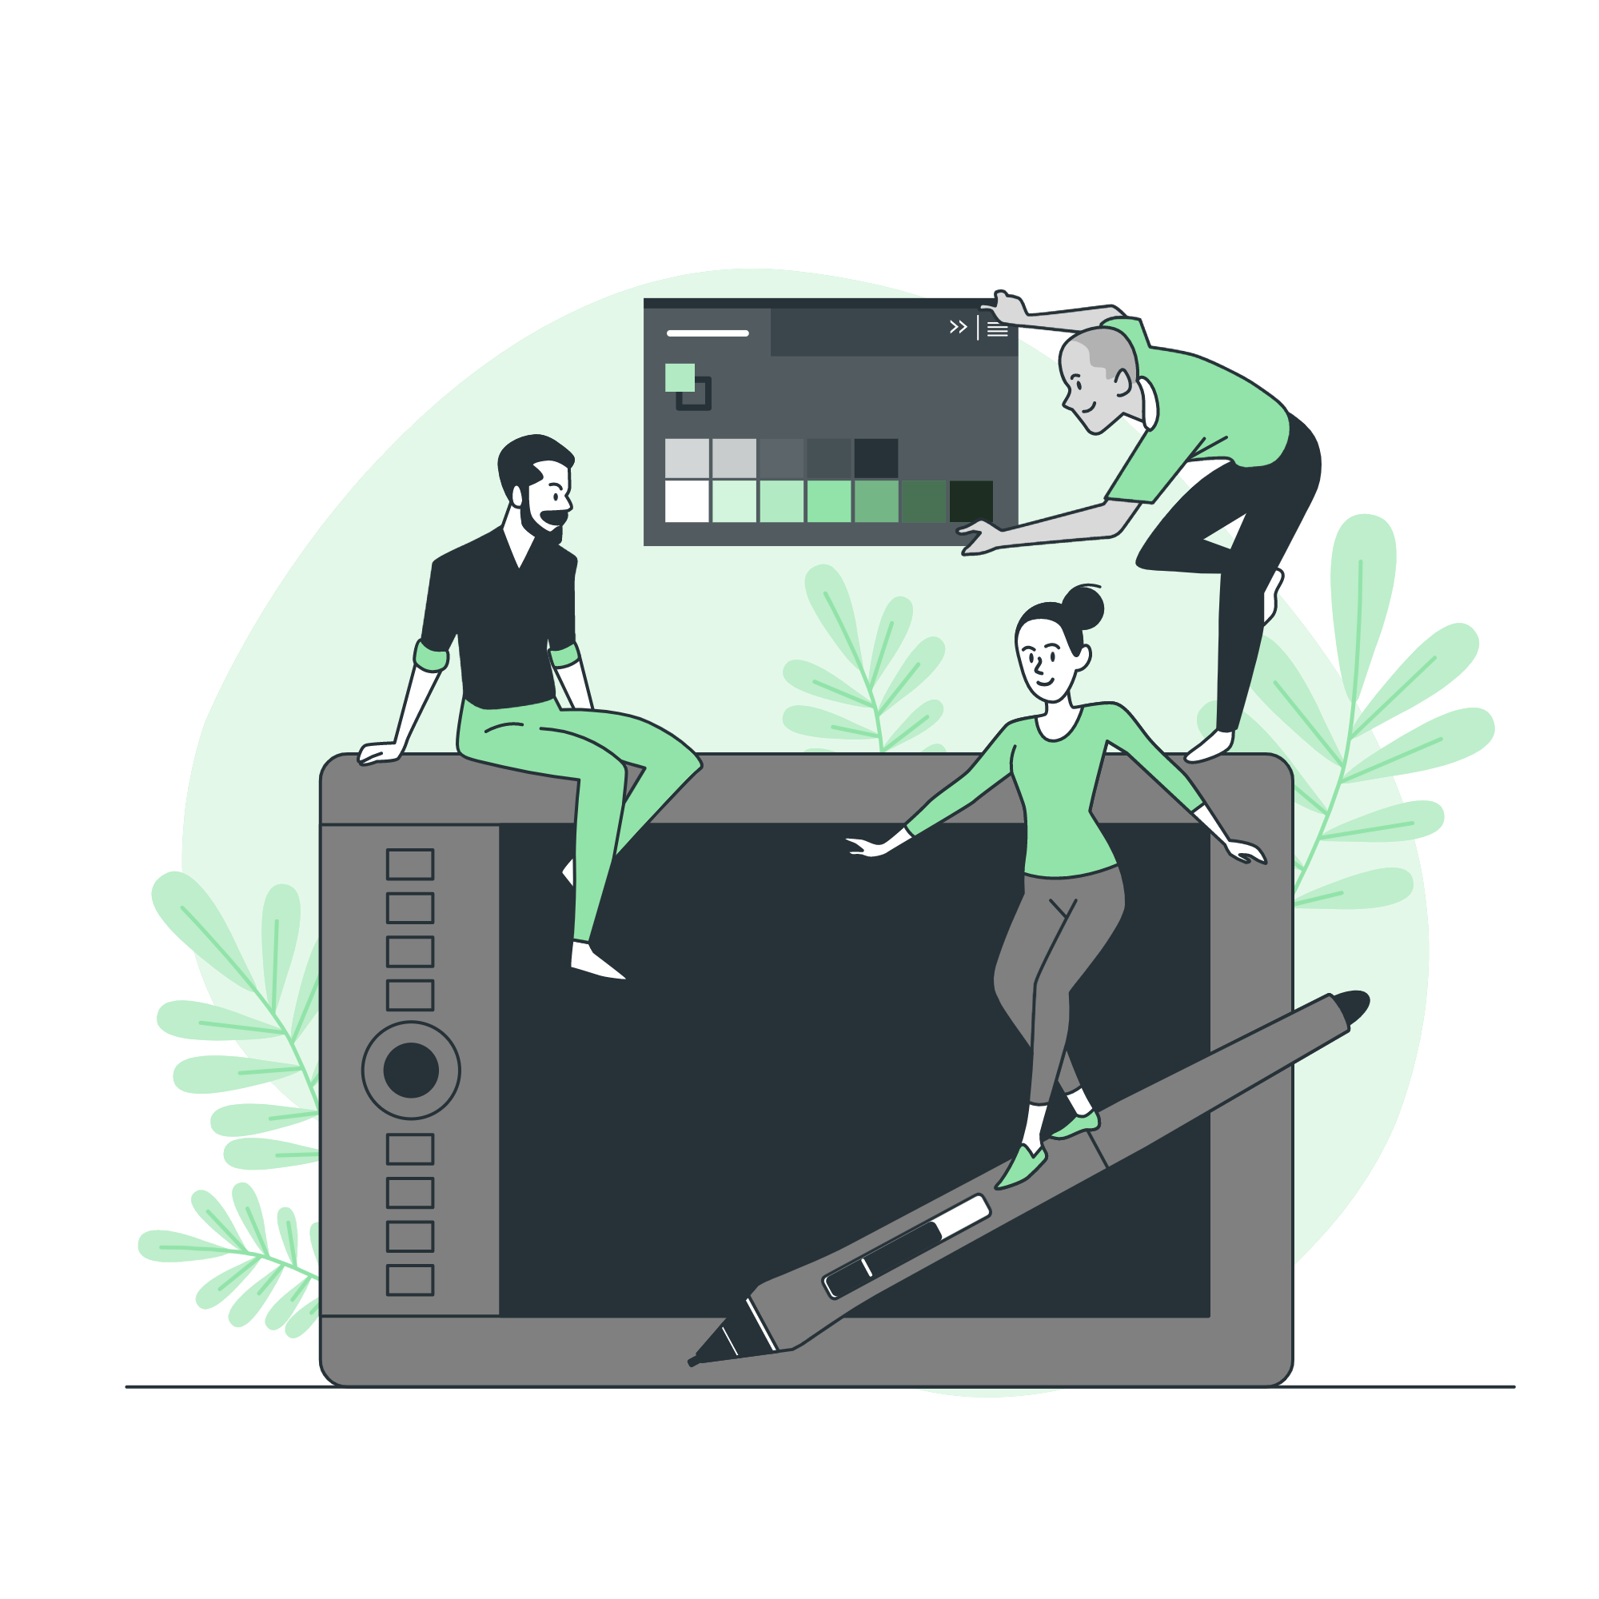

Primary Conclusions
Multi-factorial approach reduces false positives
CPL analysis effectively differentiates fair from engine-assisted play
Game context (complexity, phase, time control) crucial for accurate detection
Neural Network models achieve 95% accuracy in classification

Slide 33
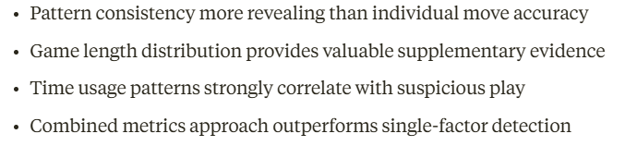
Key Findings

Slide 34

Practical applications
tournaments
55%
Tournament screening tool for arbiters
Chess sites
45%
Platform-level implementation for online chess sites
Educational resource for fair play enforcement

Slide 35
10
Future work

Slide 36
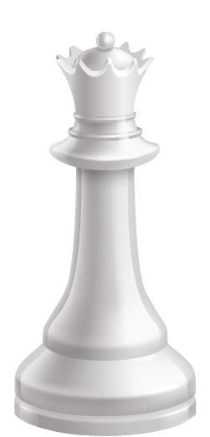
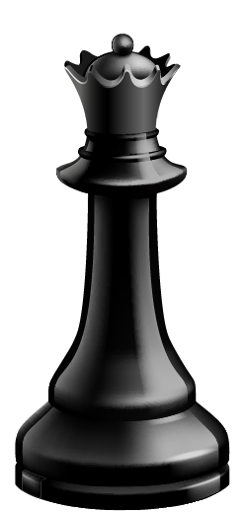
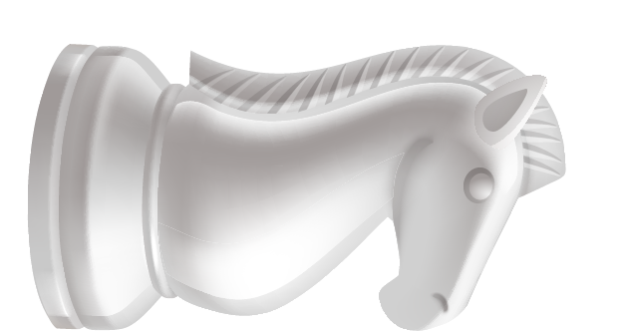
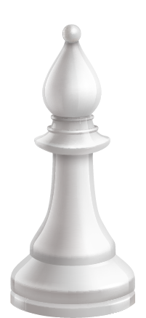
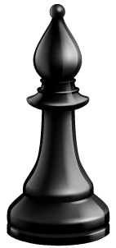
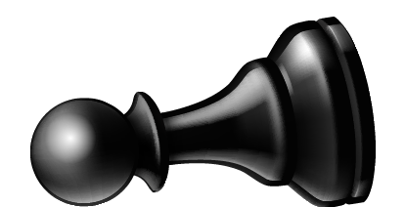
Technical enhancements
Real-time analysis capability for tournament monitoring
Cloud-based implementation for scalability
Mobile application for arbiters and tournament directors
Integration with chess platform APIs

Slide 37
Improvements and Research Extensions
Methodological Improvements:
- Expanded training dataset with more confirmed cases
- Advanced neural network architectures (LSTM, Transformer)
- Incorporation of psychological factors and playing style
- Adaptive thresholds based on time control and player rating
Research Extensions:
- Application to other strategic games (Go, Shogi)
- Self-improving detection through continuous learning
- Combined hardware/software solutions for tournament play

Slide 38
Acknowledgements
Supervision and guidance
Milin Shah, Bank of America (Primary Supervisor)
BITS Pilani Department of AI & ML Faculty
Technical support
Stockfish Development Team
Python-chess Library Contributors
Data sources
Chess.com Research Dataset
Lichess Open Database
Research assistance
Chess Community Forum Contributors
Fellow BITS Pilani Students & Researchers

Slide 39
Acknowledgements continued
Chess community friends
Manan Pahwa, Purdue University (EECS), Indiana, USA
PGN dataset contributions (chess.com) for test cases and sample games
Providing expert perspectives on human play patterns
Invaluable feedback on early detection algorithms
Dissertation idea incubator
Chess coach
Moin Memon, Bank of America, GBS Chess Championship Winner 2022
Assistance with testing across various skill levels
Local chess club member participant for controlled testing
Tournament coordinator sharing insights on practical implementation needs

Slide 40
11 & 12
Discussion + Q&A

Slide 41
Panel members
Any feedback and questions for me?

Slide 42
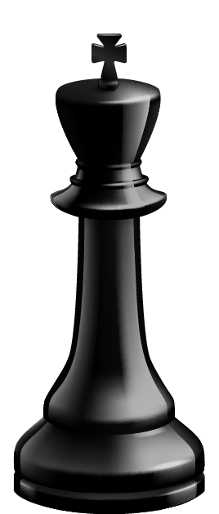
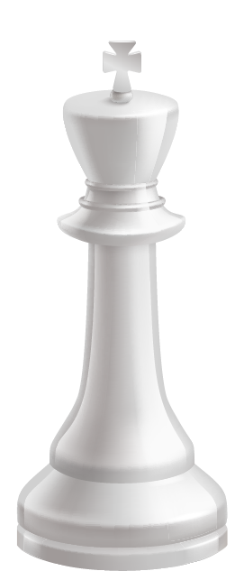
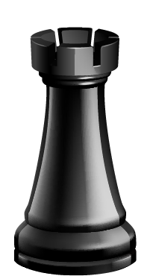
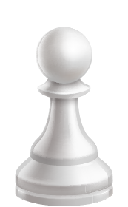

THANK YOU
Any questions? Please reach out to me –
2022AC05327@wilp.bits-pilani.ac.in
+91 7490054195

Slide 43
